Slide 1
NERS 551 Nuclear Reactor Dynamics Winter, 2021 Lecture 6: Chapter 6 No.1 Prof. T. Downar

Slide 3

Exact Point Kinetics
Adjoint Flux:
$$ψ(r,E,t)$$
Exact Point Kinetics Equation:

Slide 4
The Point Reactor Model - 1

Slide 5
The Point Reactor Model - 2

Slide 7
“Big Picture”
Ch 5 Exact Point Kinetics (Eq. Eq. 5.34)
w/ assumptions -> Point Reactor Model
Ch 6
Simplify Delayed Neutron Source -> one group delayed neutrons
Application to CONSTANT reactivity insertion (ie NO FEEDBACK)
SOLUTION w/ one group delayed neutronics … Eq. 6.109
Superprompt
Subprompt
Ch 8 Time-dependent Reactivity
8.1 Subprompt PJA Eq 8.10 (MSLB)
8.2 Superprompt
Ch 10 Time-dependent Reactivity w/ Feedback
10.1 Linear Feedback Model
10.2 Measurement of doppler coefficient in SEFOR using subprompt
10.3 Superprompt RIA transient … e.g. Control Rod Ejection

Slide 8
Contents

Slide 11
Solution of PKE w/ 6 Grp Delayed Neutrons

Slide 12
Solution of PKE w/ 6 Grp Delayed Neutrons

Slide 13
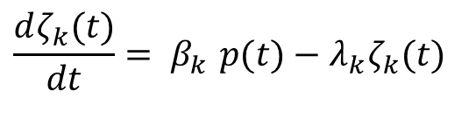
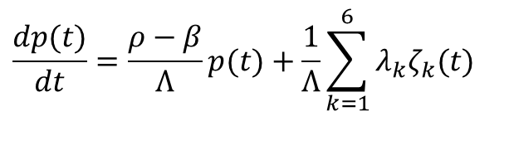
PKE: Roots for Specified Reactivity
$$\frac{dp(t)}{dt}=\frac{ρ−β}{Λ}p(t)+\frac{1}{Λ}\sum_{k=1}^{6}{λ_{k}ζ_{k}(t)}$$
$$\frac{dζ_{k}(t)}{dt}{= β}_{k}p(t)−λ_{k}ζ_{k}(t)$$

Slide 14
Solution of 1-Group Delayed Neutrons

Slide 15
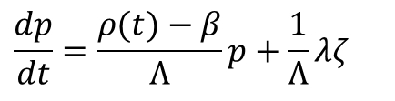
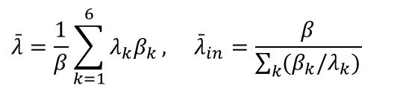
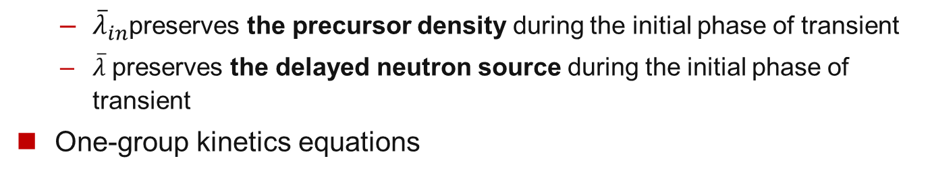
One Delayed Group Kinetics Equation
Condense six group delayed neutron precursors into one group
One-group decay constant needs to be defined properly
$$\bar{λ}=\frac{1}{β}\sum_{k=1}^{6}{λ_{k}β_{k}}, {\bar{λ}}_{in}=\frac{β}{\sum_{k}{(β_{k}/λ_{k})}}$$
${\overline{λ}}_{in}$preserves the precursor density during the initial phase of transient
$\overline{λ}$preserves the delayed neutron source during the initial phase of transient
One-group kinetics equations
$$\frac{dp}{dt}=\frac{ρ(t)−β}{Λ}p+\frac{1}{Λ}λζ$$
This system of two 1st order ODEs can be reduced to a 2nd order ODE by eliminating the reduced precursor concentration

Slide 16
Constant Delayed Neutron Source Approximation

Slide 18
Precursor Accumulation Approximation - 1

Slide 19
Precursor Accumulation Approximation - 2

Slide 21
How to Collapse Six Delayed Groups to ONE Group? - 1

Slide 22
How to Collapse Six Delayed Groups - 2

Slide 23
How to Collapse Six Delayed Groups - 3

Slide 24
How to Collapse Six Delayed Groups - 4

Slide 25
Contents

Slide 26
Solution of 1-Group Delayed Neutrons

Slide 27
Solution of 1-Group Delayed Neutrons

Slide 28
Solution of 1-Group Delayed Neutrons

Slide 29
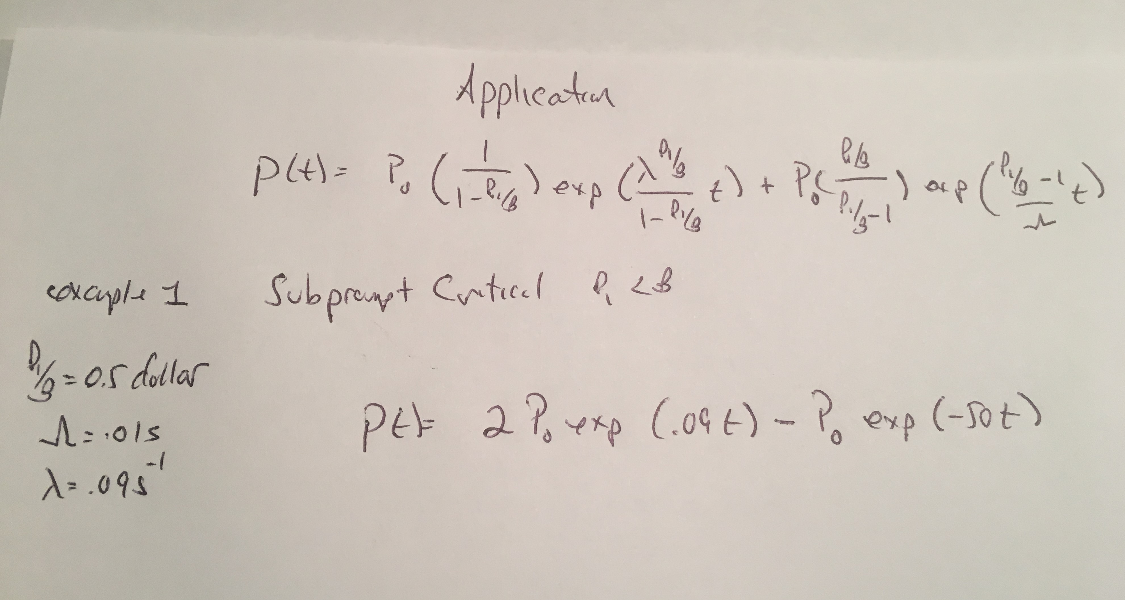
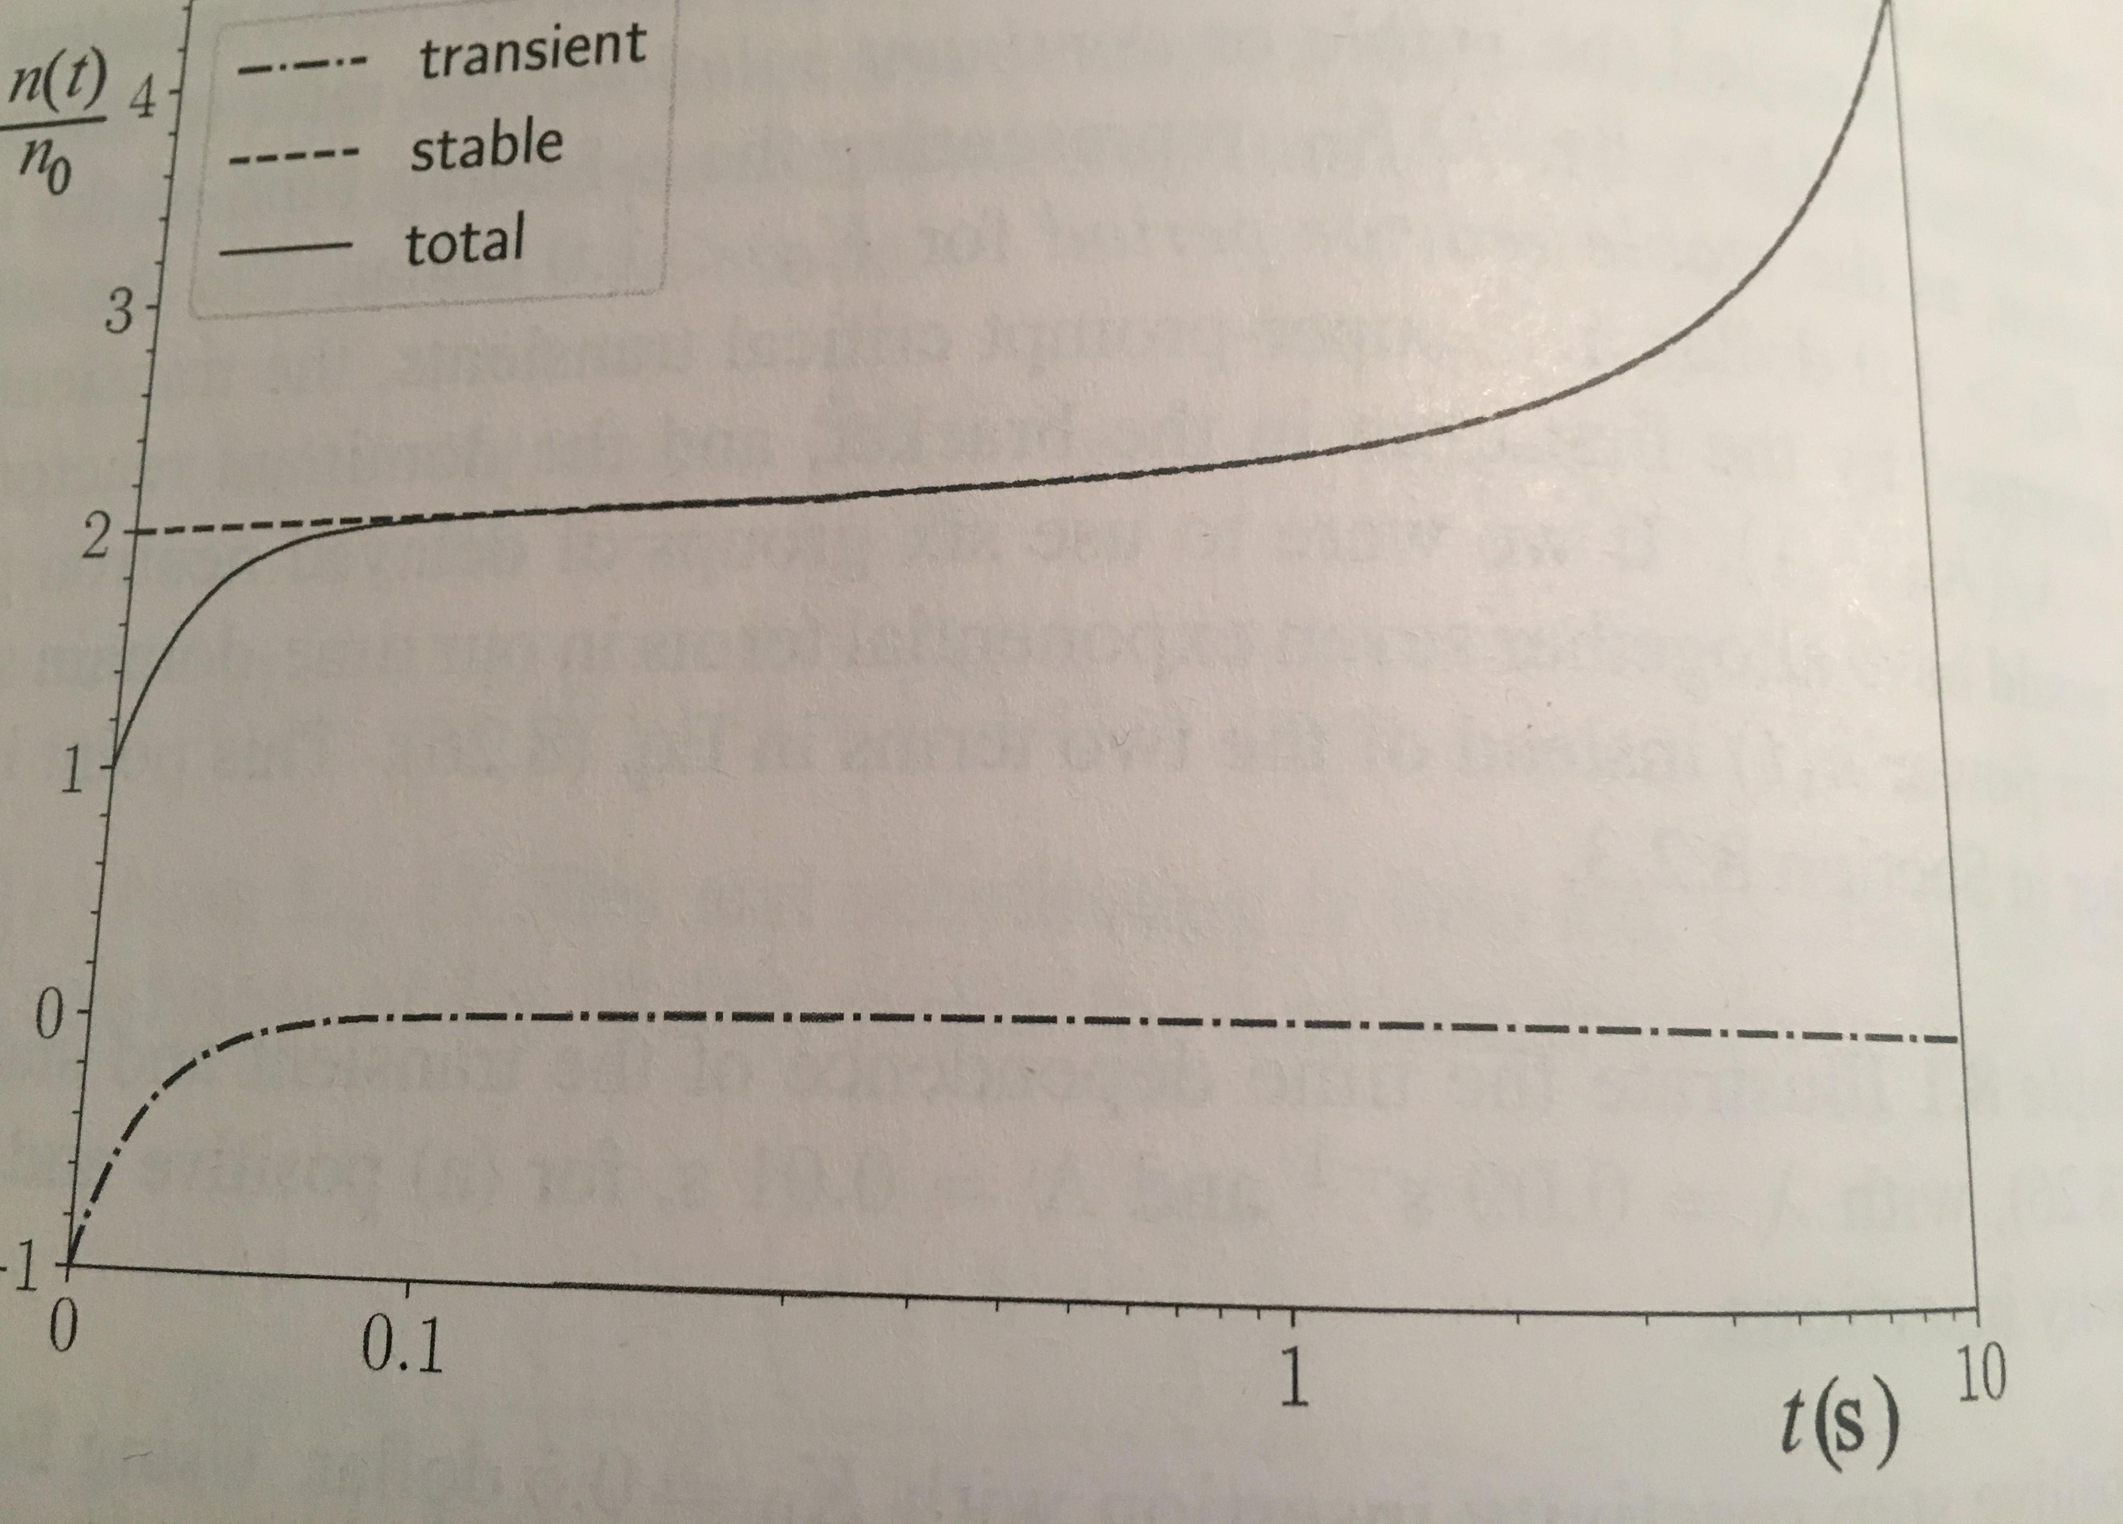
PKE Solution w/ 1 Delayed Neutron Grp: Examples

Slide 30
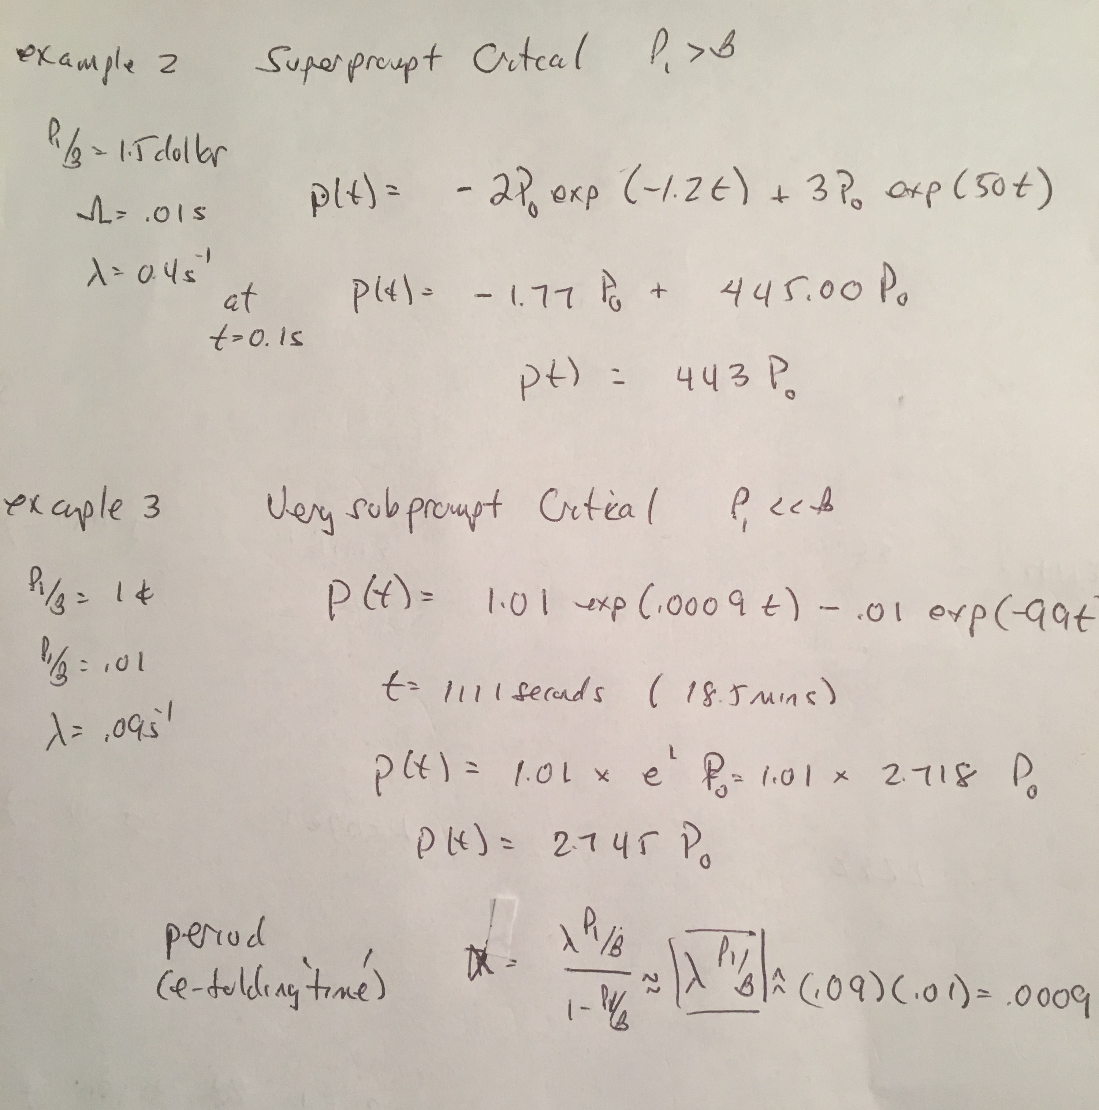
PKE Solution w/ 1 Delayed Neutron Grp: Examples II

